Slide 1
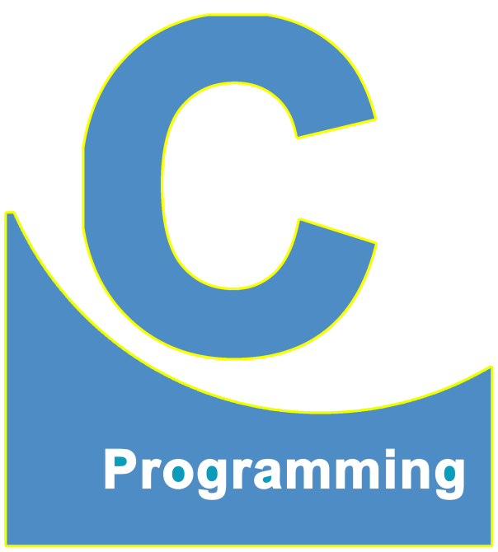
01
02
C Language
Lecture 9
04

Slide 2


Today’s Agenda
01
Rules For Declaring Variables
02
Integers Data Type In C Language

Slide 3

Rules For Declaring Variables
1. All variable names must be unique and should not contain
any keyword.
Sample :
#include <stdio.h>
#include <conio.h>
void main()
{
int r;
float r;
}
Multiple
Declaration for ‘r’

Slide 4
Rules For Declaring Variables
Sample :
#include <stdio.h>
#include <conio.h>
void main()
{
int char;
float r;
}
Keyword
cannot be
used variable name

Slide 5
Rules For Declaring Variables
Sample :
#include <stdio.h>
#include <conio.h>
void main()
{
int r;
float R;
}
This is Ok but not
recommended

Slide 6
Rules For Declaring Variables
Sample :
#include <stdio.h>
#include <conio.h>
void main()
{
int Char;
float r;
}
This is Ok but We should
avoid this

Slide 7

Rules For Declaring Variables
2. Variable names can contain alphabets as well as digits but
they must begin with an alphabet
Sample : int r1;
int r11;
int roll;
int 1r;
int 1;
int 12;
Variable names
should not
begin with a
digit

Slide 8
Rules For Declaring Variables
3. No special character like @, #, $, & etc are allowed in the
variable name.
However underscore is permitted. Moreover variable names
can even begin with an underscore

Slide 9
Rules For Declaring Variables
Sample :
float simple interest:
float simpleinterest;
float simple_interest;
int roll no;
int roll.no;
Space is not allowed

Slide 10
Rules For Declaring Variables
Sample :
int roll_no;
int rate_of_growth_of_sal;
int a_;
int _a;
int _1;

Slide 11
Rules For Declaring Variables
Sample :
int 1_;
int _;
int _a_;
int __;
Variable
names cannot start with
digit

Slide 12
Rules For Declaring Variables
4. In a C language program, all variable names must be declared before
calling any function.
Variables which are declared after function call will produce
SYNTAX ERROR in C.
However in C++ it is perfectly valid to declare variables after calling
any function.

Slide 13

Rules For Declaring Variables
For Example :
#include <stdio.h>
#include <conio.h>
void main()
{
int a;
clrscr();
.
.
.
.
}

Slide 14

Rules For Declaring Variables
For Example :
#include <stdio.h>
#include <conio.h>
void main()
{
clrscr();
int a;
.
.
.
.
}
In C language after
function call variable
declaration
not allowed

Slide 15
Rules For Declaring Variables
For Example :
#include <stdio.h>
#include <conio.h>
void main()
{
clrscr();
int a;
.
.
.
.
}
In C++ language
This is Ok.

Slide 16
Rules For Declaring Variables
5. Multiple variables of the same data type can be declared in
one row together separated with comma.
Sample :
#include <stdio.h>
#include <conio.h>
void main()
{
int p;
int c;
int m;
clrscr();
.
.
}

Slide 17
Rules For Declaring Variables
Sample :
#include <stdio.h>
#include <conio.h>
void main()
{
int r, char g, float p;
clrscr();
.
.
.
.
}

Slide 18
Rules For Declaring Variables
Sample :
#include <stdio.h>
#include <conio.h>
void main()
{
int p,c,m;
clrscr();
.
.
.
.
}

Slide 19
Rules For Declaring Variables
Sample :
#include <stdio.h>
#include <conio.h>
void main()
{
int r; char g; float p;
clrscr();
.
.
.
.
.
}

Slide 20
Rules For Declaring Variables
Sample :
#include <stdio.h>
#include <conio.h>
void main()
{
int r;
char g;
float p;
clrscr();
.
.
.
}

Slide 21
Rules For Declaring Variables
6. In C language, the maximum length of a variable name can be
up to 32 characters and in C++ it can be up to 255 characters.
However these ranges might vary as per the compiler.
Variable name have no role in their size (no of bytes consumed in
memory). It totally depends on the data type of the variable.

Slide 22
Rules For Declaring Variables
For Example :
int r; int roll_number;
Both will occupy 2B in Turbo and 4B in GCC Compiler
We must strictly follow all the rules from 1 to 6 mentioned above,
Otherwise the compiler will generate syntax error and the code will
not Be compiled.

Slide 23
Integers Data Type
Integers Date Type in C Language
Date Type Name | Size (In Bytes) | Format Specifier | Range
int OR signed int | 2B (TC) | %d, %i | -32768 to 32767
unsigned int | 2B(TC) | %u | 0 to 65535
long int OR signed long int | 4B | %ld | -2147483648 to 2147483647
unsigned long int | 4B | %lu | 0 to 4294967295

Slide 24
Integers Data Type
If we cross the LIMITS / RANGE set for a Data Type then C language does not generate any kind of error, but it ROTATES (Arithmetic Overflow) the value
On opposite end.
For Example:
OUTPUT
#include <stdio.h>
void main()
{
int a=32768;
printf(“%d”,a);
………
}
-32768

Slide 25
Integers Data Type
If you want to store values beyond the above range
then use float data type
Range of float Data Type is: -3.4*10³⁸ to 3.4*10³⁸

Slide 26
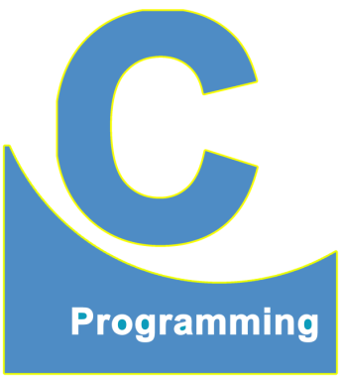
End of Lecture 9
For any queries mail us @: scalive4u@gmail.com
Call us @ : 0755-4271659, 7879165533
Thank you

